Slide 1
Creating a Family Emergency Communications Plan
Presentation sponsored by

Slide 2
What’s been done
Why Make A Communications Plan?
Your family may not be together if a disaster strikes.
Ask yourself: How will my family/household:
Get emergency alerts and warnings?
Get to safe locations for relevant emergencies?
Get in touch if cell phone, internet, or landline doesn’t work?
Get to a safe meeting place after the emergency?
Let our loved ones know we are safe?

Slide 3
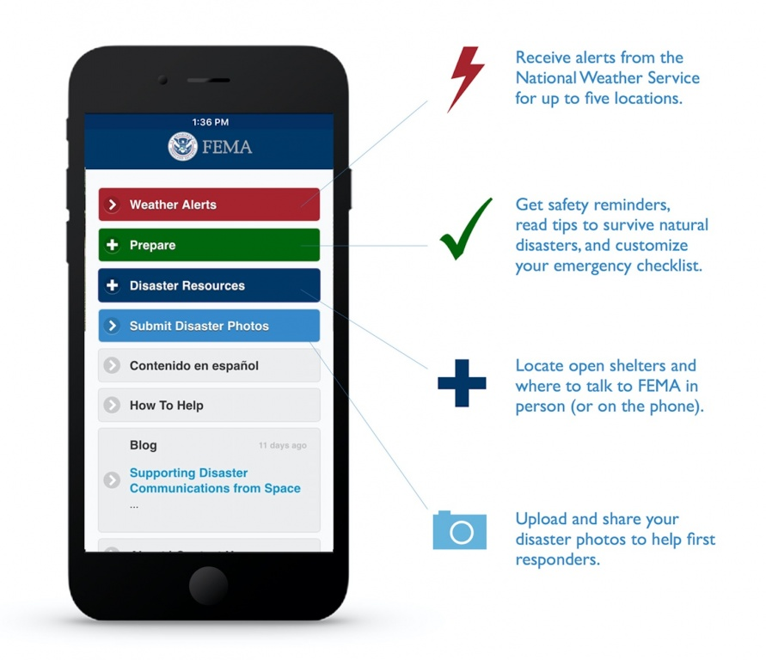
Get Tech Ready!
Sign up for FEMA alerts and monthly preparedness tips:
text “PREPARE” to 43362
Get the apps! – Red Cross, National Weather Service, National Hurricane Center
Get local apps – PRESENTER: INSERT LOCAL EMERGENCY MANAGEMENT AND NEWS APP INFO

Slide 4
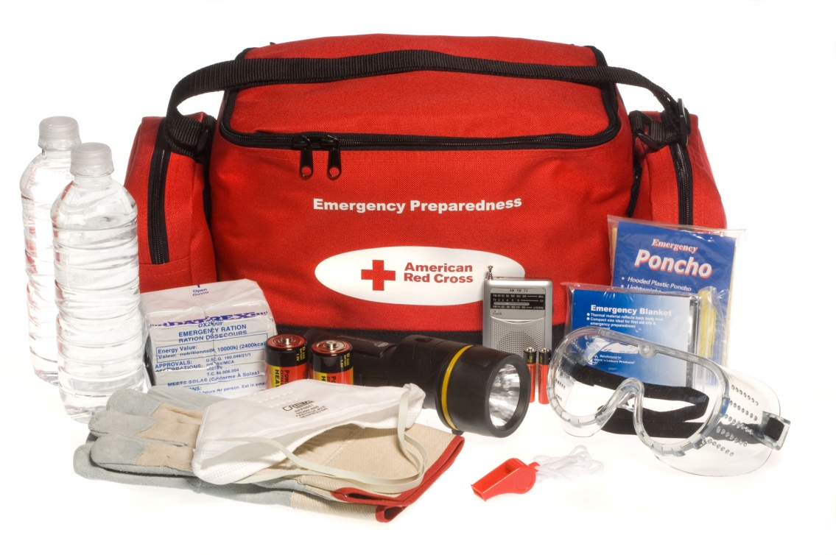
Build a Kit!
A disaster supplies kit is simply a collection of basic items your household may need in the event of an emergency.
Assemble your kit BEFORE an emergency, when you can think clearly. You will not have time during an actual emergency, and you may forget critical items. Do NOT expect to be able to shop for anything.
Pack supplies so you and your family can manage by yourself for at least three days and nights. It may take a while for help to arrive.

Slide 5
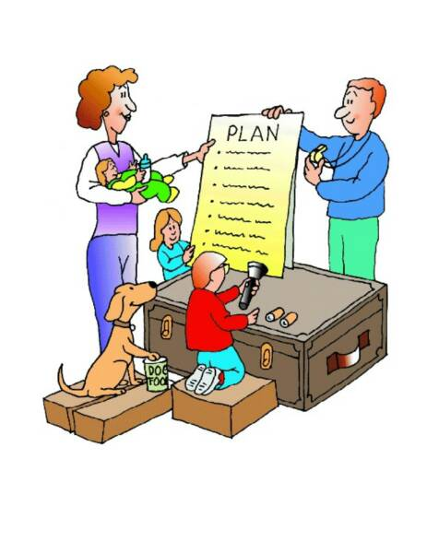
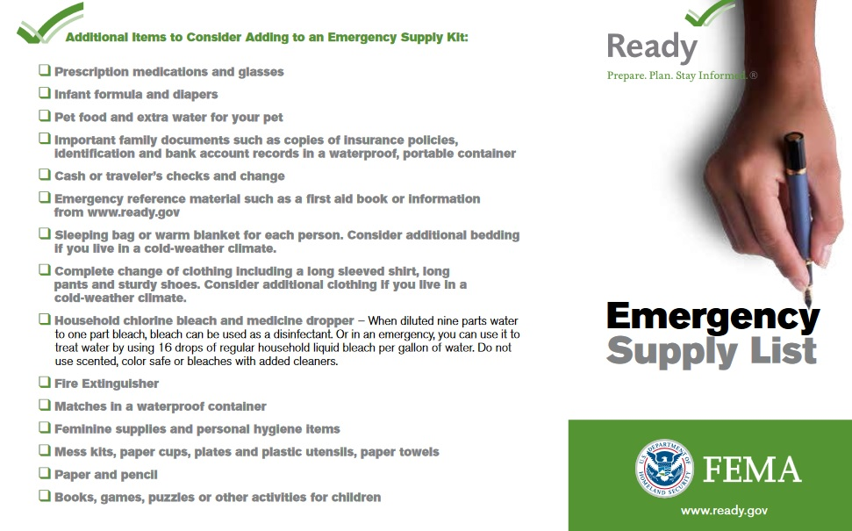
Build a Kit!

Slide 6
The Family Emergency Communications Plan
Emergencies can happen at any time.
Before an emergency happens, have a family discussion to determine:
A person out of state that all family members notify in an emergency
How to contact immediate family members if you are separated
A family meeting place AWAY from your home; both in the immediate neighborhood and within your town.

Slide 7
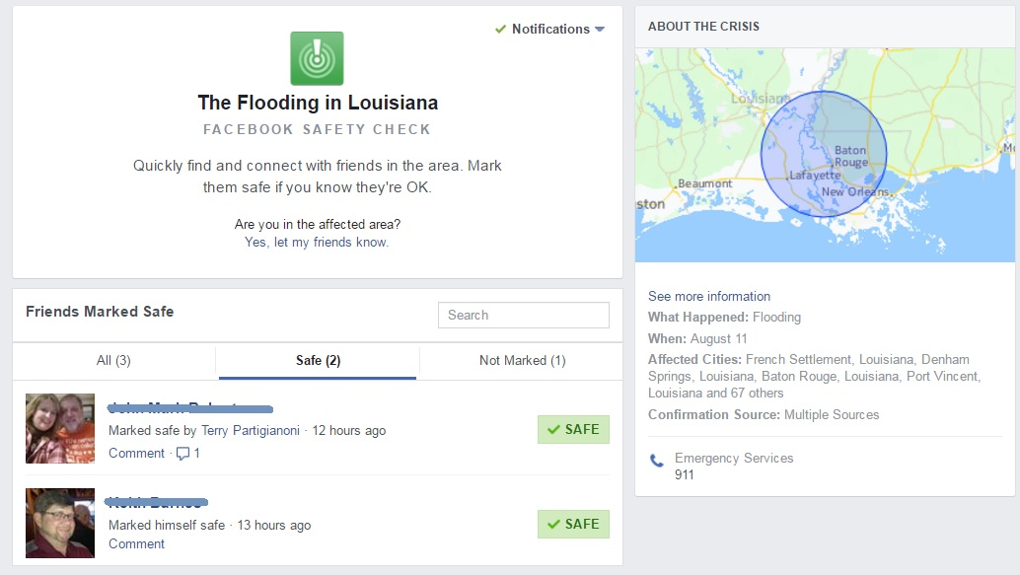
The Family Emergency Communications Plan
Goals
Get up to date information and news
Keep in touch with family members
Let loved ones know you are OK
Keep In Mind!
Cellular service, landline phones, and internet may be disrupted
Text often works better than voice when cell service is down or overloaded
Check in on Red Cross Safe and Well or by using social media such as Facebook Safety Check

Slide 8
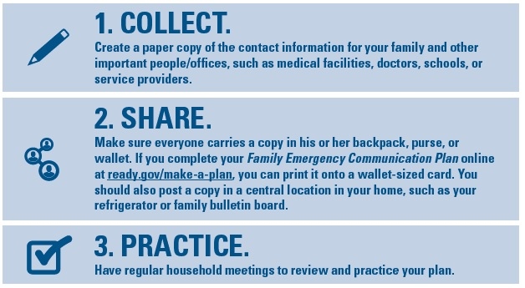
The Family Emergency Communications Plan: Using the Template

Slide 9
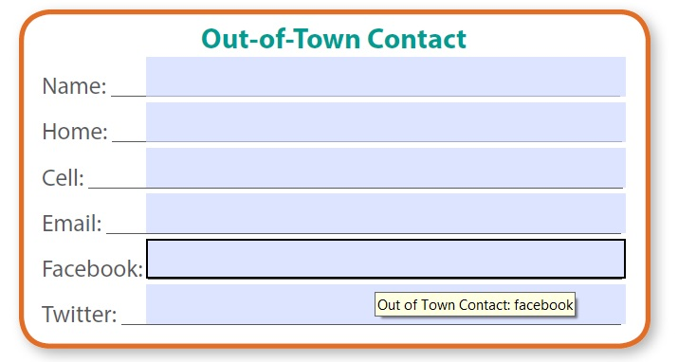
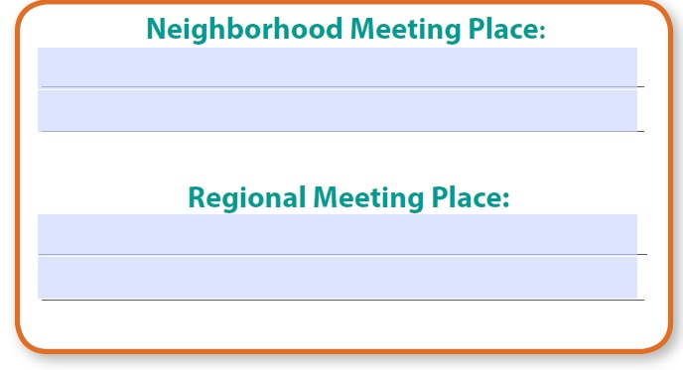
Collect
Household Information – Phone numbers and email addresses
School, Childcare, Caregiver, and Workplace Emergency Plans
Disasters may strike during work or school hours
Sign up for text alerts from work or school
Make sure children know to follow instructions from a responsible adult (teacher, principal, etc) if parents are not there
Out of Town Contact – make that person a central point of contact for all family members
Emergency Meeting Place
Indoor – tornadoes, hurricanes and high wind events. Interior protection.
Neighborhood – in case you need to leave your home – a big tree, mailbox, neighbor’s house
Outside your neighborhood: in case you can’t get back to your home. Library, community center, place of worship, friend’s house
Outside your town or city – in case of evacuation
Other Important Numbers and Information

Slide 10
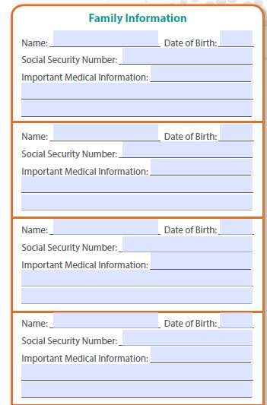
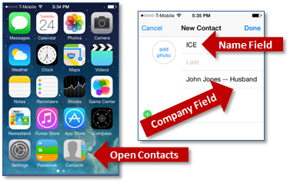
Share
Make copies of your Family Emergency Communications Plan for each member of the household
Enter household and emergency contact information
Store at least one emergency contact under the name “In Case of Emergency” or “ICE” for all mobile phones and devices
Create a group list on all mobile devices of all people you would need to communicate with during a disaster – Learn about smart phone apps such as WhatsApp
Make sure every member of the household and your emergency contacts know how to text – this is a good chance for kids to teach parents and grandparents
Read Be Smart. Know Your Alerts and Warnings and sign up to receive emergency information

Slide 11
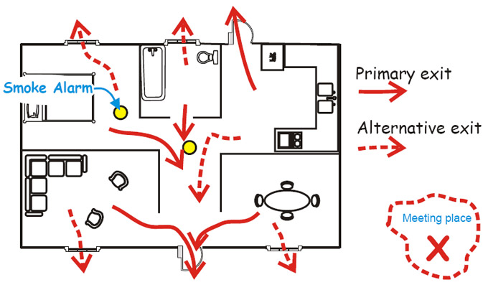
Practice
Practice texting and calling each other
Discuss what information you should send by text. Have kids teach older adults about common text abbreviations.
Appoint a lead person to send out information about the designated meeting place to the household.
Practice meeting at designated meeting places.
Talk about the plan regularly.
Challenge family members to recite important numbers from memory.
Make sure everyone knows how and when to call 911.
Review, update and practice your Family Emergency Communications Plan at least once a year.

Slide 12
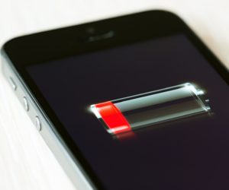
Tips for Communicating in Disasters
Text is best! Keep voice calls short. Wait at least 10 seconds between calls
Conserve your battery – reduce screen brightness, turn down volume, place phone in airplane mode, close apps you do not need, limit watching videos and playing games.
Have back up batteries and chargers. Portable USB cell phone chargers are cheap insurance; get some.
Do not text or call while driving
Maintain a household landline phone.
If you have call forwarding make sure to send calls to your cell if you evacuate
If internet is available, make use of email and social media to communicate that you are OK – Safe and Well and Facebook Safety Check
If you do not have a cell phone, keep a pre-paid phone card on hand.
Look into other communications systems to keep in touch with family during a disaster – Family Radio Service (FRS) and Amateur (“ham”) Radio

Slide 13
For more information:
Links
FEMA – www.fema.gov
www.ready.gov
National Weather Service – www.weather.gov
National Hurricane Center – www.nhc.noaa.gov
Red Cross – www.redcross.org
Your local Amateur Radio Group:
PRESENTER: INSERT CONTACT INFO

